Slide 1
A focus on safety, efficiency and profits
Bike Share Analysis
By Vincent Perez

Slide 2
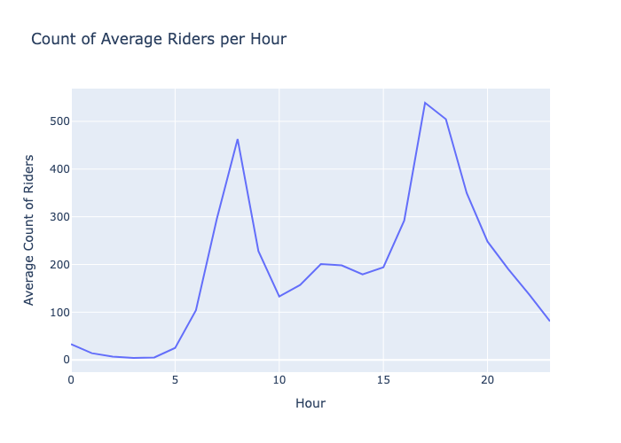
Data Overview
I chose to subset the data using the "workingday" column where "workingday" is equal to 1.
Subset represents weekends (Monday through Friday)
Excludes holidays
Focuses on bulk of data
Supported by Welch’s T-Test on hypothesis testing slide
After plotting subset:
Found a bimodal distribution
Potential profitable hours during peak morning and peak evenings.

Slide 3
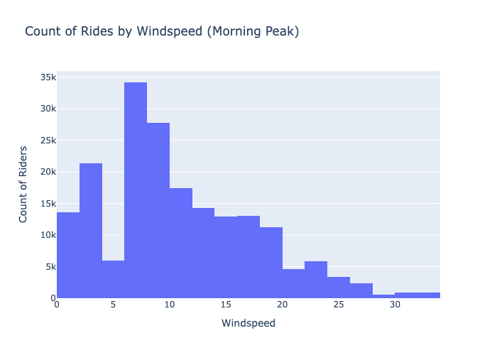
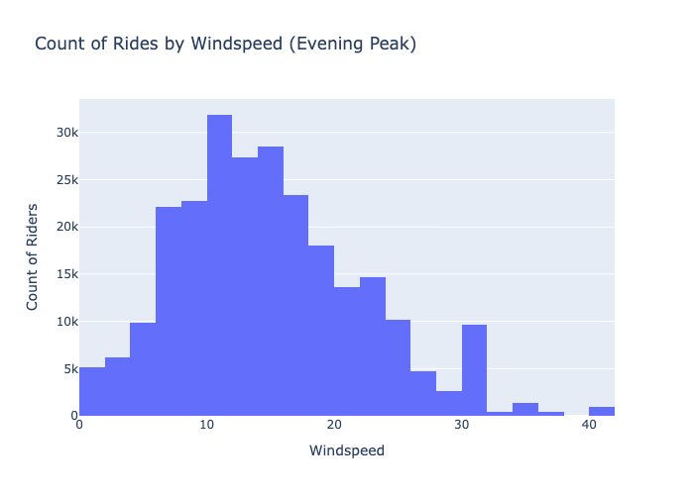
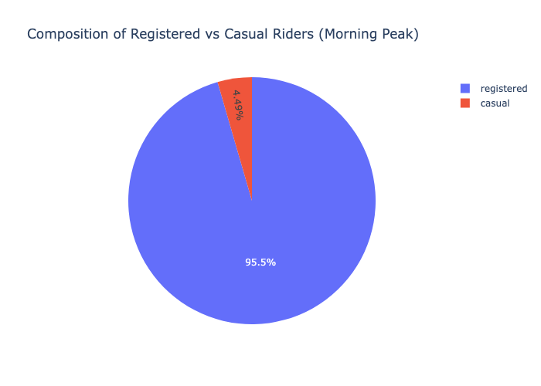
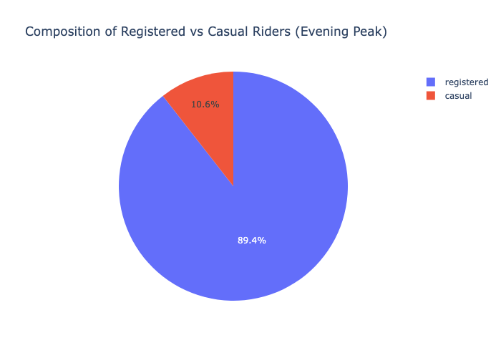
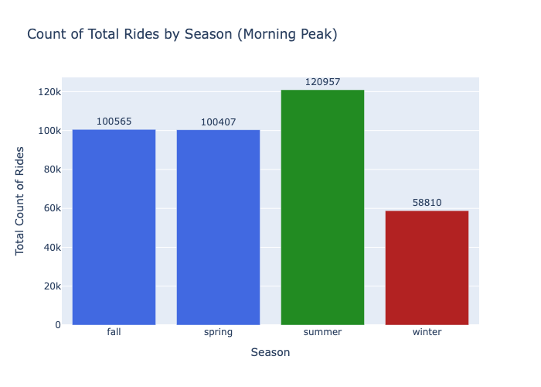
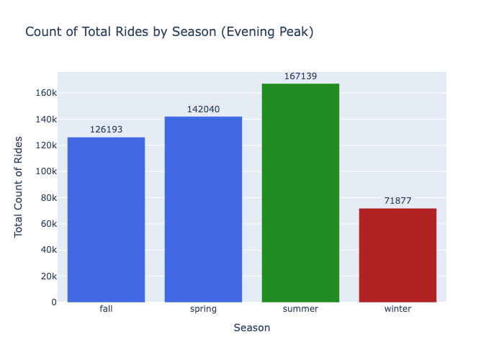
Safety
Morning and Evening peak winds exceed 30 miles per hour.
Evening winds go up to 40 mph
Most riders wind speed ranges from 0-20 mph
Rider Composition
Many riders are registered users compared to casual in both morning and evening peaks
Evening composition consists of a higher percentage of casual riders
Seasonality
Summer is the most popular season for riders, having the highest sum of riders on both morning and evening peaks.
Second-highest sum of riders season for morning and evening peaks differ.

Slide 4
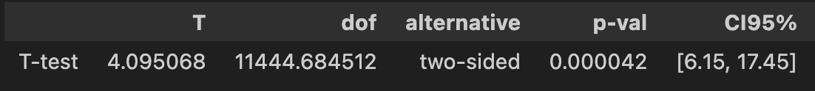
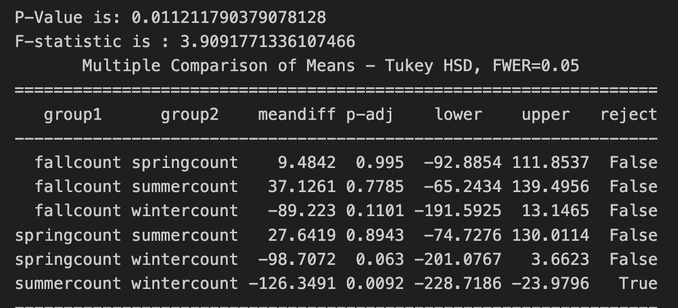
Hypothesis Testing
Image of Welch’s T-Test on conducted using Pengouin
Test 1:
Statical Test: Two Sample Welch’s T-Test
Alpha: 0.05
P-Value: 0.000042
Confidence Interval: [6.15, 17.45]
Decision: Reject the Null Hypothesis & statistically
significant difference between
“workingdays” and not “workingdays”
Image of ANOVA test with Tukey’s Test below it
Test 2:
Statical Test: One-Way ANOVA
Alpha: 0.05
P-Value: ~0.01121
Decision: Reject the Null Hypothesis and there is a
statistical difference between at least one of our season’s hourly means

Slide 5
A/B Testing for New Change
The Set Up
The Result
After conducting a small change to the app, we did an A/B Test:
Requirements: During 17:00-19:00 on working
days when weather is good
Pre (Baseline): 2012-08-04 → 2012-08-31
Post (Feature On): 2012-09-01 → 2012-09-28
H 0: The change made no difference in total commuter ridership on workdays during the evening.
H 1: The change made a difference in total commuter ridership on workdays during the evening.
P-Value: 0.021958
Confidence Interval: [-102.64, -8.4]
Cohen-d: 0.411091
-With a P-Value less than our alpha at 0.05 to ensure value was not due to randomness, we must reject the Null Hypothesis, and the change did make a difference.
-The power being high indicates it is reasonable to assume the test was accurate, The cohen-d value indicates the change would be big, so I would not advise a change unless supported by multiple tests to drastic effects on guardrails, leading to customer dissatisfaction
Image of Welch’s T-Test conducted on Pengouin

Slide 6
Next steps
Marketing
Promotional Offers for our Riders
Operations
Hours for Maintenance
Safety
Warn for Environmental Factors
- Create offers to decrease casual riders for evening peak with an incentive to register.
- Winter is a good time for Hypothesis Testing, as the impact is lower but enough riders to collect data and observe effects.
Hours of 23:00-5:00 are best suited to do maintenance work, as our average count of bikers are low compared to all other hours. Use these hours to prepare for out peak hours late on in the day.
Let riders know when winds are higher than 20mph so they are aware of dangerous conditions, especially during peaks.. Features include a warning before undocking a bike from the station.

